Slide 1




Research Presentation
“Robust and Sparse Linear Discriminant Analysis via an Alternating Direction Method of Multipliers”
by Chun-Na Li, Yuan-Hai Shao, Wotao Yin, and Ming-Zeng Liu
Notes:
I. Introduction
- Overview of the problem being studied
- Importance of solving the problem
II. Limitations of Classical LDA
- LDA's susceptibility to polluted data
- The SSS problem in L2-norm-based LDA
III. Robust and Sparse Linear Discriminant Analysis
- Explanation of the proposed method
- Benefits of the method over classical LDA
IV. Alternating Direction Method of Multipliers (ADMM)
- Overview of ADMM
- How ADMM is applied to the proposed method
V. Experimental Results
- Description of the experiments conducted
- Comparison of the proposed method to other methods
- Discussion of the results
VI. Conclusion
- Summary of the paper's contributions
- Future work and potential areas for improvement

Slide 2
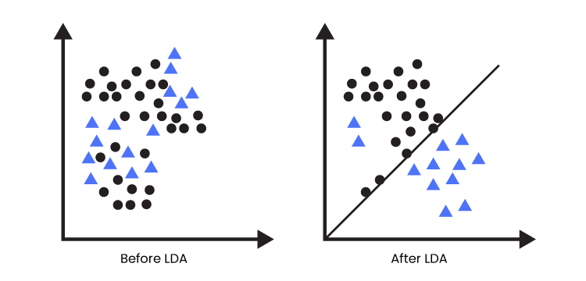
Introduction

Slide 3
Overview of the problem being studied

Slide 4
Importance of solving the problem

Slide 5
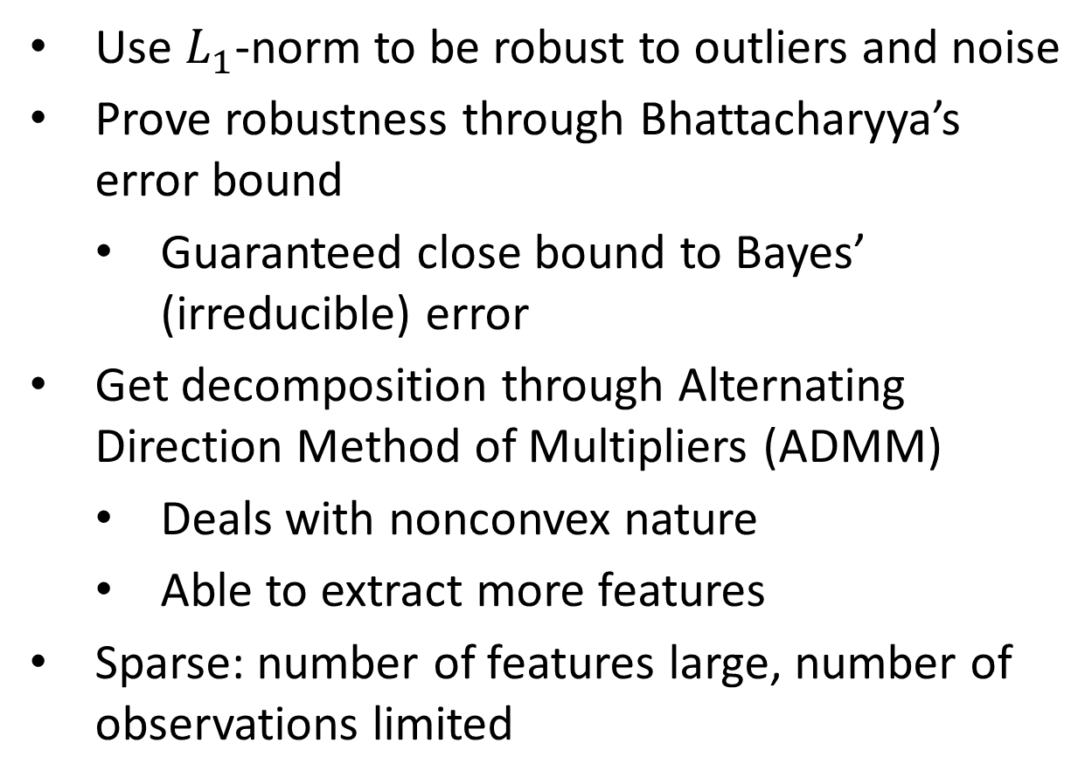
Robust LDA
Use $L_{1}$-norm to be robust to outliers and noise
Prove robustness through Bhattacharyya’s error bound
Guaranteed close bound to Bayes’ (irreducible) error
Get decomposition through Alternating Direction Method of Multipliers (ADMM)
Deals with nonconvex nature
Able to extract more features
Sparse: number of features large, number of observations limited
Notes:
Let’s talk about the paper’s contribution. We know that L1-norm provides more robustness to outliers and noise, but how? We can use Bhattacharyya’s error bound, a measure of how similar two distributions are. The two distributions we compare are the data and its dimensionally-reduced projection. Minimizing this error is essential in getting accurate reductions. Thankfully, the authors proved that it’s a close bound to Bayes’ irreducible error.
For dimensional reduction to happen, we need a way to get the most important features. Typically, you would use eigendecomposition, but we use an Alternating Direction Method of Multipliers instead for L1-norm. Not only can it work with the nonconvex nature of LDA, it also doesn’t have the same restriction where the number of features must be one less than the number of classes.
A variant of RLDA, Sparse RLDA, can work with fewer observations and extract more features.

Slide 6
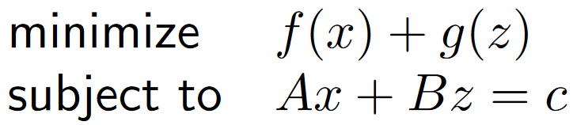
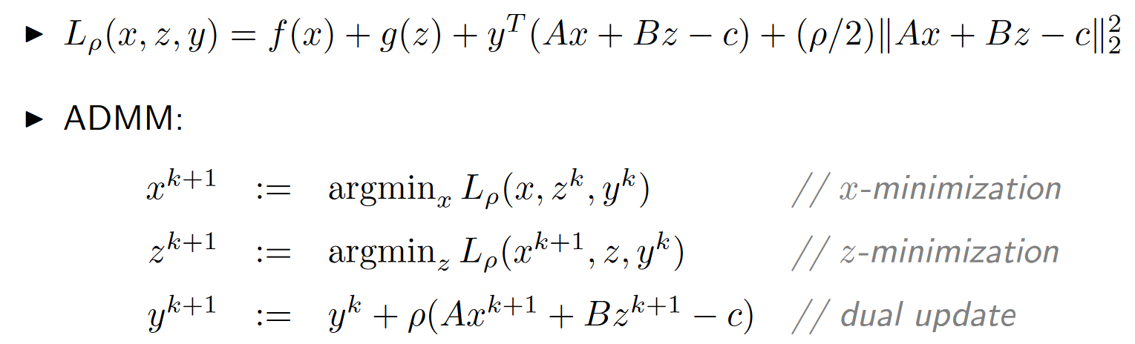
Alternating Direction Method of Multipliers
Rewrite the minimization to the form
Add penalty
We know how to minimize efficiently
Figure. [2]
Figure. Augmented Lagrangian and minimization of two variables [2]
Notes:
Alternating Direction Method of Multipliers is unique in how it optimizes. Instead of minimizing any generic function with one variable, it minimizes the sum of two functions with different variables.
If we add a penalty to the sum, then we create an augmented Lagrangian. This helps us because other researchers found an efficient way to minimize both variables at the same time within one iteration. Finding the arguments of the minima for both variables can also be done in parallel, speeding up computation.

Slide 7
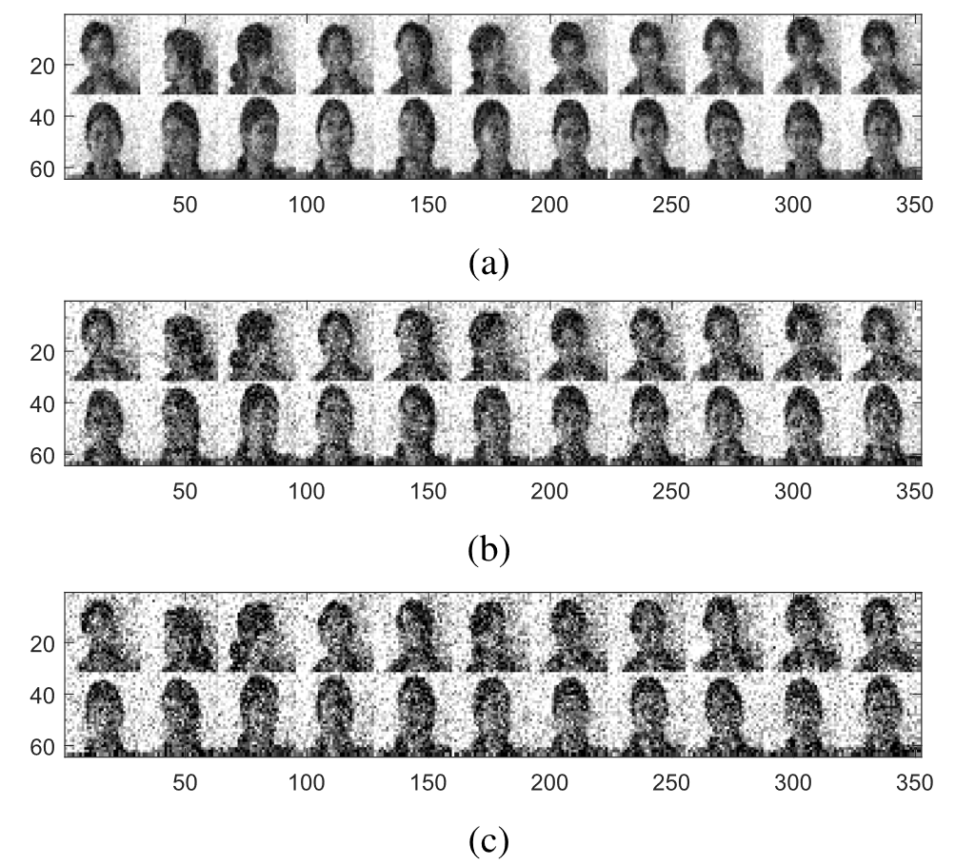
Methodology
Compare multiple dimensionality reducing algorithms
Use artificial and real datasets
Measure accuracy and time
Figure. Samples of the noisy female Indian dataset [1]
Notes:
In order to test whether their Robust LDA has real improvement, the authors decided to test it against both artificial and real datasets. Here, they compare it against PCA, Principal Component Analysis, PCA with L1-norm, LDA, regularlized LDA, LDA with L1-norm, and other methods.
For their datasets, they created two datasets with 2 dimensions, with both dimensions being normally distributed with different parameters. Each dataset has 50 samples, but one dataset has one outlier and the other has two outliers. For the real dataset, they used the images of Indian female faces, with each image being 32x32 pixels and 8-bit grayscale. To test robustness, they add normally distributed noise to each image.

Slide 8
Citations
[1]: C. -N. Li, Y. -H. Shao, W. Yin and M. -Z. Liu, "Robust and Sparse Linear Discriminant Analysis via an Alternating Direction Method of Multipliers," in IEEE Transactions on Neural Networks and Learning Systems, vol. 31, no. 3, pp. 915-926, March 2020, doi: 10.1109/TNNLS.2019.2910991.
[2]: Distributed Optimization and Statistical Learning via the Alternating Direction Method of Multipliers (Boyd, Parikh, Chu, Peleato, Eckstein)
Notes:
In order to test whether their Robust LDA has real improvement, the authors decided to test it against both artificial and real datasets. Here, they compare it against PCA, Principal Component Analysis, PCA with L1-norm, LDA, regularlized LDA, LDA with L1-norm, and other methods.
For their datasets, they created two datasets with 2 dimensions, with both dimensions being normally distributed with different parameters. Each dataset has 50 samples, but one dataset has one outlier and the other has two outliers. For the real dataset, they used the images of Indian female faces, with each image being 32x32 pixels and 8-bit grayscale. To test robustness, they add normally distributed noise to each image.

Slide 9
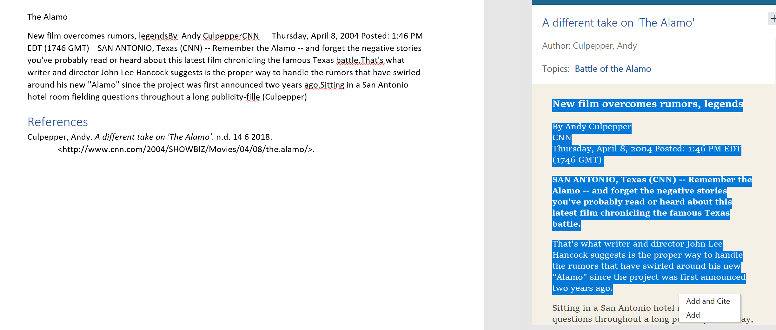
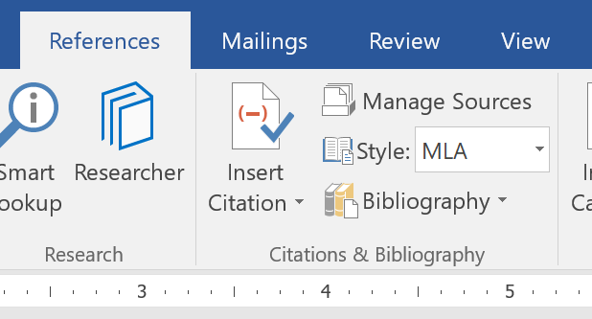
Slide 3
3
Select the text you would like to add to your research notes and then choose if you want to Add or Add and Cite. To avoid plagiarism, make sure you add quotation marks around the text so you know it came from the source.
The citation format will match the one you selected in the References tab. This citation is APA style, but you can change it to the one given by your teacher or instructor.
4

Slide 10
Vary Your Sources
Refer to the notes section below for guidelines on this topic.
Notes:
When conducting research, it is easy to go to one source: Wikipedia. However, you need to include a variety of sources in your research. Consider the following sources:
Who can I interview to get more information on the topic?
Is the topic current and will it be relevant to my audience?
What articles, blogs, and magazines may have something related to my topic?
Is there a YouTube video on the topic? If so, what is it about?
What images can I find related to the topic?

Slide 11

Evaluate Your Sources
Refer to the notes section below for guidelines on this topic.
Notes:
Once you find your sources, you will want to evaluate your sources using the following questions:
Author:
Who is the author?
Why should I believe what he or she has to say on the topic?
Is the author seen as an expert on the topic? How do you know?
Current:
How current is the information in the source?
When was the source published?
Is the information out-of-date?
Accuracy:
Is the content accurate?
Is the information presented objectively? Do they share the pros and cons?

Slide 12
Narrow Your Topic
Refer to the notes section below for guidelines on this topic.
Notes:
After consulting a variety of sources, you will need to narrow your topic. For example, the topic of internet safety is huge, but you could narrow that topic to include internet safety in regards to social media apps that teenagers are using heavily. A topic like that is more specific and will be relevant to your peers. Some questions to think about to help you narrow your topic:
What topics of the research interest me the most?
What topics of the research will interest my audience the most?
What topics will the audience find more engaging? Shocking? Inspiring?

Slide 13
Organize Your Research
Refer to the notes section below for guidelines on this topic.
Notes:
Now, that you have narrowed your topic, you will want to organize your research in a structure that works. There are some common organizational patterns based on the kind of research you are doing.
Organizational Structures:
Cause and Effect- this kind of structure is great for explaining the causes and effects of a topic
Compare and Contrast- in this pattern you highlight the similarities and differences of the topic
Explain process- this structure is great for outlining a series of steps to follow;
Definition- if you want to make sure your audience understands what something is using illustrations, meanings, clarifying misconceptions, you may want to use this structure
Classification- a common organizational structure is grouping like topics or facts from the research together. For instance, in the internet safety about social media apps, you may organize the research where you look at each social media app one at a time

Slide 14
Present Your Research
Refer to the notes section below for guidelines on this topic.
Notes:
After you’ve done your research, it’s time to put your presentation together. The first step in the process is to introduce the topic. This is a great time to connect your topic to something that your audience can relate. In other words, why should they listen to all the information you will be sharing in your research presentation? What is in it for them? You may also want to include a graphic or image to grab their attention.
Feel free to duplicate this slide by right-clicking on this slide in the slides pane to the left and select Duplicate Slide.
The next step in your presentation is to state your claim or topic clearly. Your teacher may even call this your thesis. As you state your thesis, you may find that this layout is not the best layout for your claim or topic. You can change the layout by clicking the drop-down menu next to the Layout in the Slides menu section. You can choose Two Content, Comparison, or Picture with Caption. Note: A different layout might change the look of the icons on this page.
You will also want to state your facts. You have done the research now share some of the interesting facts with your audience. Facts do not have to be boring; you can communicate facts in a variety of ways by going to the Insert Tab. In the Insert tab you can:
Insert pictures from your computer or online.
Add a chart
Create some SmartArt
Insert a variety of icons to help your facts come to life. Note: You can change the color of the icons by selecting the icon and then click on the Format tab and then Graphics Fill. From there, you will choose a color from the list or choose More Fill Colors to give you more options.
Since this research presentation is a result of your hard work and searching, you want to make sure you support the claims or points in your presentation with facts from your research findings. Make sure you give the author proper credit for helping you share your ideas. If one of your sources has a video that is relevant to your topic, you can add the video as added support. Keep in mind the length of the video and the amount of time you have for your presentation. For a 5 minute speech, the video should be no longer than 30 seconds.
Questions to consider:
How will you state the author of the source?
Will you need to cite the source on the slide?
What are some ways you can engage your audience so they feel like they are a part of the presentation? Some ideas to consider is by taking a quick poll like: by a show of hands, how many of you think school uniforms are a way to cut down on bullying? Another suggestion is to have them hold up a certain number of fingers to see if they agree or disagree. Finally, you can share a story that the audience can relate to that makes them laugh.
After all the applause, your audience may have some questions. Be prepared to answer some of their questions by making a list of questions you think they might ask. You may also want to share the presentation with them by providing the link to your presentation, if they want more information.

Slide 15
Research Presentation End
Notes:
You can use this slide as your opening or closing slide. Should you choose to use it as a closing, make sure you review the main points of your presentation. One creative way to do that is by adding animations to the various graphics on a slide. This slide has 4 different graphics, and, when you view the slideshow, you will see that you can click to reveal the next graphic. Similarly, as you review the main topics in your presentation, you may want each point to show up when you are addressing that topic.
Add animation to images and graphics:
Select your image or graphic.
Click on the Animations tab.
Choose from the options. The animation for this slide is “Split”. The drop-down menu in the Animation section gives even more animations you can use.
If you have multiple graphics or images, you will see a number appear next to it that notes the order of the animations.
Note: You will want to choose the animations carefully. You do not want to make your audience dizzy from your presentation.

